Slide 1


Arduino Class Programming with Examples
An Introduction
Alan Lomax
M8640

Slide 2
Agenda
Ground Work – Types and Structures
Basic Concepts - What is a Class ? How does it work?
Sample Code Fragments
How and Why use a Class?
Some Example Code snippets
Inspecting the LED2 Class in some detail
Notes:
Introduce Self!
Classes are a fundamental part of Object Oriented Programming, building on some prior programming knowledge
Review Agenda

Slide 3
Ground Work
Variable Types
int, bool, string, float, char[] (and others)
Underneath all of these it is just bits and bytes of binary code
When we declare a type we tell the compiler how to interpret the binary
This is ‘bread and butter’ for programming in Arduino (and C++)
int x = 5; // normally a 16 bit integer
bool isPlaying = false; // a Boolean is true/false
String fname = “Fred”; // a string represents text
Notes:
Fundamentals to build on
When we talk about a variable Type … know what that is referring to.

Slide 4
Types and Structures
struct (short for structure)
It is possible (and not uncommon) to define our own variable type which is a combination of the basic types given previously. A simple example:
struct structname {
String fname;
String lname;
};
structname fullName; // As with the other types you declare a new variable
int x; // for comparison a simple type declares a new variable the same way
After defining the variable you can pass around the whole structure or
refer to the individual component parts like this:
fullName.fname = “Fred”
fullName.lname = “Flintstone”
We commonly use structures to handle related data as if it were a single item.
Notes:
Next page talks about Chris Sharp’s presentations over the past few MERG sessions

Slide 5
Types and Structures
In a recent MERG Arduino SIG meeting Chris Sharp gave a presentation on structures and in particular focusing on a Servo structure he designed. (You may recall it.)
As structures were introduced it was clear that at a high level the code would be easier to maintain and develop.
But also the ‘complexity’ was still in plain view since it was in essence just a reorganizing of existing code.
Notes:
I recall the color coding to show at a high level how blocks of code were moved around.

Slide 6
New Concept: A software Class
A class:
Very similar to a struct{ } but can hide implementation details
This also means it is a way of hiding complexity
Like a struct a Class can be thought of as a user defined type
All of this to be covered …. So lets go!

Slide 7
A Software Class
1 – Define a Class
on
output
off
Led2
Class Definition
2 – Create objects using the class definition.
Objects:
myLed1
myLed2
myLed3
3 – Use each of the objects thus created independently.

Slide 8
LED2 is just an Example We could be talking about a servo class
Attach
Output Pin
Detach
Servo
Class Definition
Write
Create ‘Servo’ objects using the class definition.
Output Pin
Output Pin
Objects:
myServo1
myServo2
myServo3
Output Pin
And use each of the objects thus created independently.

Slide 9
Basic Concepts
Complexity may be hidden inside the shoebox
(But as a user we don’t care)
on
output
off
Led2
Class Definition
Complex Stuff
The objects can interact with hardware (eg: LED on/off, Servo going to a position)
The class definition determines what ‘Properties & Methods’ are available in each of the objects we have created.

Slide 10
A peek Under the Covers : the on() property
“on” Command
Led2 Class
On() is a function within the class definition that sets the private internal variable _state and _blink
myLed1.on(); // Outside the shoebox use the on method of myLed1 object
void Led2::on() {
_blink = false; // Turn off blink mode
_state = HIGH; // Set desired state LED will turn on with next call to update
}
Notes:
I hope people are underwhelmed with this … the on property is setting internal values but not actually doing anything to the LED output.

Slide 11
Going a little Deeper
A class definition is in at least two parts
- a header file (*.h) and
- a C++ program (*.CPP)
LED2
Class Definition
The header lets our sketch and the compiler know what is coming further down in the code.
- How to use the Led2 class to make a new object
- What properties and methods it has.
Name of our Class
Led2 myLed1 = Led2(13);
#include "Led2.h"
Led2 myLed1 = Led2(13);
Pin 13
myLed1
Name of our New Object
A passed parameter to be used when first constructing the object
Notes:
Note the definition is written as "LED2 myLed1 = LED2(13);“
This makes it easier to see the relationship with definition of a normal variable like "int pin = 13;" that the audience are familiar with.
Here is where it is useful to think of LED2 as a type (mentioned in (2) above.)
"LED2 myLed1(13);" does the same thing (generates the same code) but the assignment is not explicitly shown.

Slide 12
Side discussion - File Locations
The header defines the ‘entry points’ for the functions but it is the CPP program that implements the functions. Both are required.
On the previous slide I indicated you would add the following line:
#include "Led2.h"
But where do the *.h and *.cpp files actually go?
If you use “double quotes” (as shown above) then put the two files in same directory as your main sketch. This is good while developing or testing.
If you use <angle brackets> then the two files must go in your libraries folder (under the folder where you keep your sketches.)
This is good for your final class code.
The use of angle brackets (<>) causes the compiler to search the default include directory. Using double quotes ("") causes it to search the current working directory and only if that search fails the default include directory.

Slide 13
The Header File
A class definition is in at least two parts
- a header file (*.h) and
- a C++ program (*.CPP)
/*****************************************************
** LED2_H **
** **
** This class implements standard LED on-off **
** logic on a pin you specify plus a configurable **
** blinking effect. It does so without any delay **
** calls. (no blocking code) **
*****************************************************
*/
class Led2 {
private:
int _pin; // the number of the LED pin
unsigned long _onTime; // milliseconds of on-time
unsigned long _offTime; // milliseconds of off-time
unsigned long _nextTime; // next time change in milliseconds
bool _blink; // true if we are in blinking mode, false if not
{ snip }
public:
Led2(byte pin); // Simple default definition
void update(); // update things based on elapsed time (call often)
void off(); // Turning off the LED (and sets blink to false)
void on(); // Turning on the LED (and sets blink to false)
{ snip }
};
Tell compiler we are defining a class
Some variables (or functions) are private – completely inside the shoebox
Some are public – available outside the class sticking out of the shoebox
This function has same name as class and no other return type – it is the CONSTRUCTOR
This (incomplete) code is the header. Notice It tells the compiler what to expect in the CPP program … but it has no real executable code of its own.
Notes:
Note the definition is written as "LED2 myLed1 = LED2(13);“
This makes it easier to see the relationship with definition of a normal variable like "int pin = 13;" that the audience are familiar with.
Here is where it is useful to think of LED2 as a type (mentioned in (2) above.)
"LED2 myLed1(13);" does the same thing (generates the same code) but the assignment is not explicitly shown.

Slide 14
The C++ part
A class definition is in at least two parts
- a header file (*.h) and
- a C++ program (*.CPP)
#include "Led2.h"
Led2::Led2(byte pin) {
// Save the passed pin
_pin = pin;
init();
}
void Led2::init() {
pinMode(_pin, OUTPUT); // define our output pin
off(); // call the function that sets out LED to off initially
}
void Led2::off() {
_blink = false; // Turn off blink mode
_state = LOW; // Set the desired state - LED will turn off on next call to update
}
void Led2::on() {
_blink = false; // Turn off blink mode
_state = HIGH; // Set desired state LED will turn on with next call to update
}
void Led2::update() {
if (_blink) { // If in blinking mode look at timing first
if ( millis() >= _nextTime) { // It is time to do something.
_nextTime = millis() + (_state == LOW ? _onTime : _offTime); // and calculate when next
// change of state is due
_state = !_state; // swap states
}
}
digitalWrite(_pin, _state); // update the actual output according to desired state
}
Include the header
Here is our CONSTRUCTOR (name is same as class name). We pass it pin and all it does is save it in a private variable called _pin
Then call a separate function to initialize things.
Led2 myLed1 = Led2(13);
The separate function to initialize things is itself dirt simple .. It sets the pinMode and calls yet another function called off()
The separate functions on() and off() just set two internal variables.
Note that at no point so far have we actually written anything to the output.
myLed1.on();
The Magic Sauce. A public method called update. If blink is true it checks if it is time to swap states .. Otherwise carry on. And finally write the _state to the _pin
Note: No delays, no blocking code. Update executes very quickly.
myLed1.update();
Notes:
The public functions are what the outside world (ie your main program) sees.
All of the internal code is hidden complexity.
Most of the functions (or methods if you prefer) just get or set internal variables.
The update method reads and acts on the internal variables … typically doing most of the work.

Slide 15
In your Main Program
Defining it before setup makes myLed1 a global variable. It can be accessed in setup or in loop code.
#include <Led2.h>
Led2 myLed1 = Led2(13);
void setup() {
myLed1.onTime(50); // Set LED onTime (50 ms)
myLed1.offTime(300); // Set LED offTime (300 ms)
myLed1.blink(); // turn on blink mode
}
void loop()
{
myLed1.update(); // call update frequently
}
In setup configure any settings we want.
Loop code could not be simpler. The work is done inside the class checking millis() and doing the work.

Slide 16
Summary: How it all works together
1) Use The class definition and create an object like so:
LED2 myLed1 = LED2(13);
13
output
13
on
on
on
LED2
Class Definition
Object
myLed1
_pin = 13
_state = ON
Object
myLed1
_pin = 13
_state = OFF
pinMode(_pin, OUTPUT);
off
off
off
update
update
update
2) constructor runs and sets private (internal to class) variables:
_pin = 13, _state=OFF
and the mode of _pin is set to OUTPUT
3) In loop code we call the update method myLed1.update() which executes the line digitalWrite(_pin, _state)
Not too much else happens- we just turned off a pin that was probably already off!
5) When next our loop code calls myLed1.update() it will check the local variables _state and writes it to the output pin.
It is only at this point our LED will turn ON.
4) Now lets say we called the on method myLed1.on() All this does is set the local variable _state to on. At this point still nothing happens because _state is just a private variable inside our class.

Slide 17
Recapping The Key Points
Key Point #2: Although each of the objects gets its functionality from the same class definition, each object is independent and the objects do not interact .
LED2 Class Definition
LED2 myLed1(13);
LED2 myLed2(5);
LED2 myLed3(6);
LED2 myLed4(7);
myLed1 Object
Key Point #3: There is no such thing as magic!
myLed2,3,4 Objects
Key Point #1:
The object is defined by the class but is separate.
You do not need to know the inner workings of the class definition in order to use it.

Slide 18

The full Led2 class
LED2 Class
Output (Pin)
“on” Command
“off” Command
“update()”
Complexity is hidden inside the shoebox
state (T / F)
“blink” Command
“onTime (ms)”
“offTime (ms)”
“update()”
On and Off commands are hardly a compelling usage case
A blink command for our class makes it a bit more interesting
User definable on time and off times - better
Blinking an LED output without ever calling delay() is an example of hidden complexity
As a user you don’t need to know how it works, only that it does work!
After a 5 minute break … Let’s look at a live example using the code

Slide 19
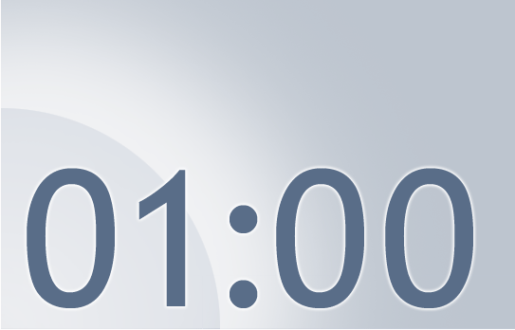






The Next Train Departs in:
Notes:
Using this PowerPoint break timer
This PowerPoint slide uses images, custom animation, and timing to provide a countdown timer that you can use in any presentation. When you open the template, you’ll notice that the timer is set at 00:00. However, when you start the slide show, the timer will start at the correct time and count down by 1-minute intervals until it gets to 1 minute. At that point, it will count down in two 30-seconds intervals to 00:00.
To insert this slide into your presentation
Save this template as a presentation (.ppt file) on your computer.
Open the presentation that will contain the timer.
On the Slides tab, place your insertion point after the slide that will precede the timer. (Make sure you don't select a slide. Your insertion point should be between the slides.)
On the Insert menu, click Slides from Files.
In the Slide Finder dialog box, click the Find Presentation tab.
Click Browse, locate and select the timer presentation, and then click Open.
In the Slides from Files dialog box, select the timer slide.
Select the Keep source formatting check box. If you do not select this check box, the copied slide will inherit the design of the slide that precedes it in the presentation.
Click Insert.
Click Close.

Slide 20
Live Demo Time
Single LED blinking
Multiple LEDs blinking with different patterns
Multiple LEDs blinking with different patterns and a Servo sweep
Notes:
Share screen show code … load code wink over to second camera describe what people are seeing.
Change timing and show effect. Pause for discussion.
Look into class code – discuss how it works.
Move to next example.

Slide 21
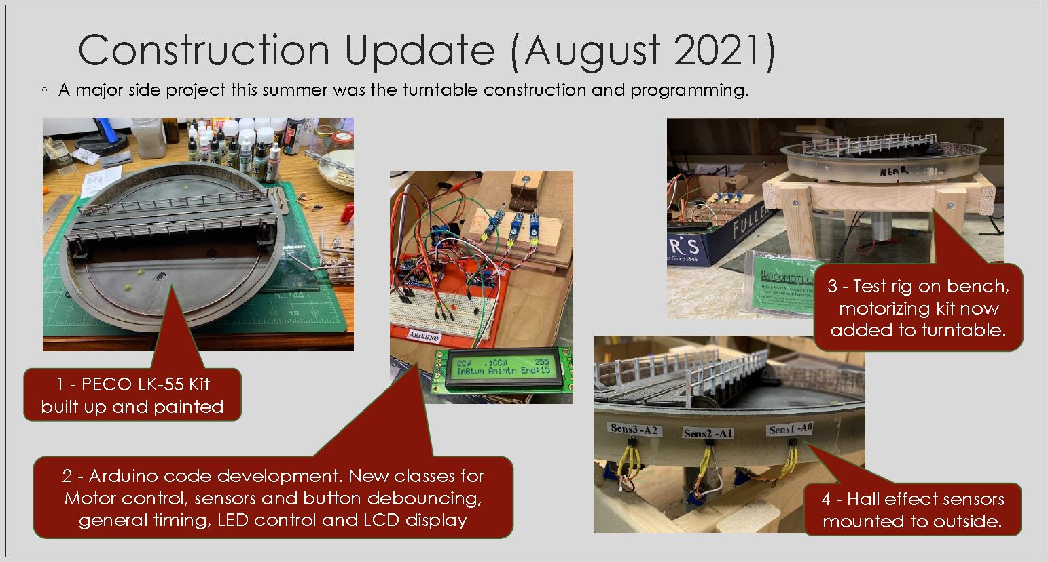
My Motivation

Slide 22
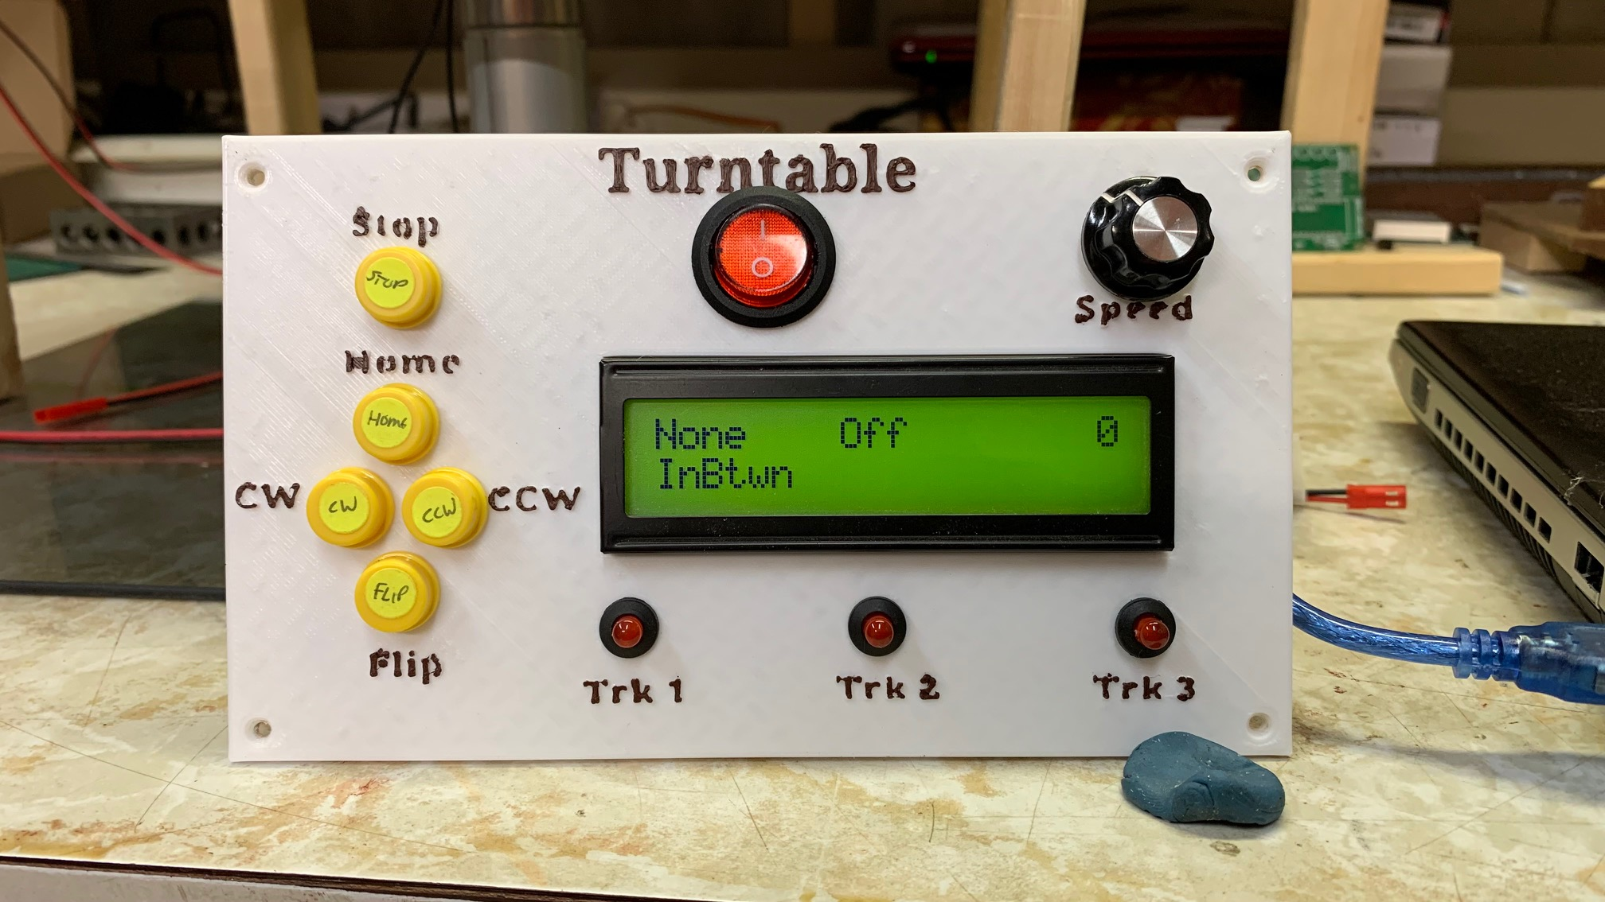
My Motivation

Slide 23
Going deeper with a code review….
LED2 Class
Lets take a look at and talk through the code:
Latest: https://github.com/Alan-Lomax/Led2
A snapshot also included later in this PPT.

Slide 24
Some More Examples (+ Inspecting Class Programming)
DblDelay https://github.com/Alan-Lomax/DblDelay
Timer https://github.com/Alan-Lomax/Timer
Button https://github.com/Alan-Lomax/Button
LCD2x20 https://github.com/Alan-Lomax/LCD_NHD2x20
LED2 https://github.com/Alan-Lomax/Led2

Slide 25
Recap
A blueprint for making software ‘objects’
A way of making re-usable software parts
A way of hiding complexity
A user defined variable type
A fundamental part of Object Oriented Programming

Slide 26
Questions?
Some Additional Reading follows
(If you are interested)

Slide 27

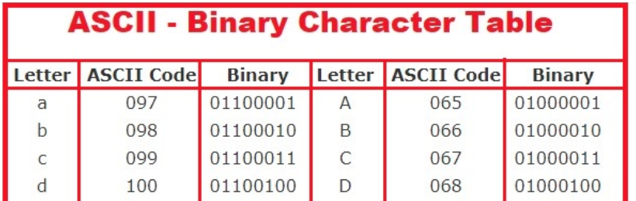
Ground Work – Types and Structures
byte x = 65;
char myLetter = ‘A’;
In binary both of these are the same bit pattern 01000001
The computer does not care.
It is only how we interpret the two variables that matters.
Lots of on line help is available (see references)

Slide 28
Why use a Class?
Comprehension (details are hidden, code is easier to understand)
Productivity (defining and using an object can be very quick)
Portability (The same class can be used in many sketches)
Testability (Testing, isolating and debugging is compartmentalized)
Inheritance (New classes can build on other classes)

Slide 29
Why Not use a Class?
For some applications they are not needed so why use a class to do what might be a trivial thing
Classes are still programs and programs do have bugs.
All that hidden complexity might represent a can of worms if you did not write the code but still need to dig into it.
There is a learning curve, especially if a class has lots of properties and methods.
Changing a class can have knock on effects to many programs that depend on it working a certain way

Slide 30
Lessons Learned
IMO: The hardest part is knowing what properties and methods are available with a given (non-trivial) class.
Not only what they are but also the many options available for a given property can also be quite involved.
These aspects are often poorly documented. Realizing the true power of a class is a challenge under such conditions and users might be reluctant to accept the implementation at face value.
An example sketch demonstrating usage of some properties is helpful – but is not sufficient if there are many options and alternate uses.

Slide 31
LED2.H
#ifndef MY_LED2_H
#define MY_LED2_H
#include "Arduino.h"
/*
*****************************************************
** LED2_H **
** **
** This class implements standard LED on-off **
** logic on a pin you specify plus a configurable **
** blinking effect. It does so without any delay **
** calls. (no blocking code) **
*****************************************************
*/
class Led2 {
private:
int _pin; // the number of the LED pin
long _onTime; // milliseconds of on-time
long _offTime; // milliseconds of off-time
bool _blink; // true if we are in blinking mode, false if not
int _state; // ledstate used to set the LED
unsigned long _previousMillis; // the last time LED was updated
void init(); // Initialization code
public:
Led2(byte pin); // Simple default definition without a pre specified on and off time.
Led2(byte pin, long on, long off); // this definition includes the on and off time values from the outset
void update(); // update things based on elapsed time (call this as often as possible)
bool getState(); // Return the current state of LED
bool getBlink(); // return the LEDs current blinking state (true / false)
void onTime(long on); // Set the onTime to a new value
long onTime(); // Return the current onTime
void offTime(long off); // Set the offTime to a new value
long offTime(); // Return the current offTime
void off(); // Set the On time to zero and the Off time to 500 - Turning off the LED
void on(); // Set the Off time to zero and the On time to 500 - Turning on the LED
void blink(); // set the LED to a blinking state using the previously set timing values
};
#endif

Slide 32
LED2.CPP (1/3)
#include "Led2.h"
Led2::Led2(byte pin, long on, long off) {
// Save the passed pin and timing values into the equivalent local variables (with underscore)
_pin = pin;
_onTime = on;
_offTime = off;
// Initialization code is kept separate just for clarity.
init();
}
Led2::Led2(byte pin) {
// Save the passed pin
_pin = pin;
init();
}
void Led2::init() {
pinMode(_pin, OUTPUT);
// Initialize local variables for the new class member
_state = LOW; // start with LED on the off condition
_blink = false; // no blinking at initialization
off(); // call the function that sets out LED to off initially
}

Slide 33
LED2.CPP (2/3)
void Led2::update() {
// check to see if it's time to change the state of the LED
unsigned long currentMillis = millis();
if (!_blink) { // If not in blinking mode just look at on or off conditions
if (_state == LOW) {
digitalWrite(_pin, LOW); // Turn off the actual LED.
}
else if (_state == HIGH) {
digitalWrite(_pin, HIGH); // Turn on the actual LED.
}
}
else { // We are in blinking mode so cycle accordingly
if ((_state == HIGH) && (currentMillis - _previousMillis >= _onTime)) {
_state = LOW; // Turn it off
_previousMillis = currentMillis; // Remember the time
}
else if ((_state == LOW) && (currentMillis - _previousMillis >= _offTime)) {
_state = HIGH; // turn it on
_previousMillis = currentMillis; // Remember the time
}
digitalWrite(_pin, _state); // update the actual LED.
}
}
bool Led2::getState() {
// return the current state of the led (True or False)
return _state;
}
bool Led2::getBlink() {
// return the current blink state of the led (True or False)
return _blink;
}
void Led2::onTime(long on) {
// update the desired on time of the led
_onTime = on;
}

Slide 34
LED2.CPP (3/3)
long Led2::onTime() {
// return the current on time of the led
return _onTime;
}
void Led2::offTime(long off) {
// update the desired off time of the led
_offTime = off;
}
long Led2::offTime() {
// return the current off time of the led
return _offTime;
}
void Led2::off() {
_blink = false; // Turn off blink mode
_state = LOW; // Set the desired state - LED will turn off on next call to update
}
void Led2::on() {
_blink = false; // Turn off blink mode
_state = HIGH; // Set the desired state - LED will turn on on next call to update
}
void Led2::blink() {
_blink = true; // Turn on blink mode
// Set the desired state - LED will start blinking as of next call to update
}

Slide 35
References and Additional Material
Binary numbers and types :
http://users.ece.utexas.edu/~valvano/embed/chap3/chap3.htm
Alternate explanations on subject of Classes:
https://www.guru99.com/cpp-classes-objects.html
http://mypractic.com/lesson-7-classes-in-c-language-for-arduino-button-as-an-object/
https://www.geeksforgeeks.org/c-classes-and-objects/
http://paulmurraycbr.github.io/ArduinoTheOOWay.html

